Slide 1
The Erdős Institute Data Science Bootcamp Fall 2023
Forecasting Financial Markets: Predictive Modeling Using S&P 500 Data
By Guess-timate Gang (Hitesh Gakhar, Michail Paparizos, Kriti Sehgal, Limin Wang)
Group Mentor: Soheyl Anbouhi

Slide 2
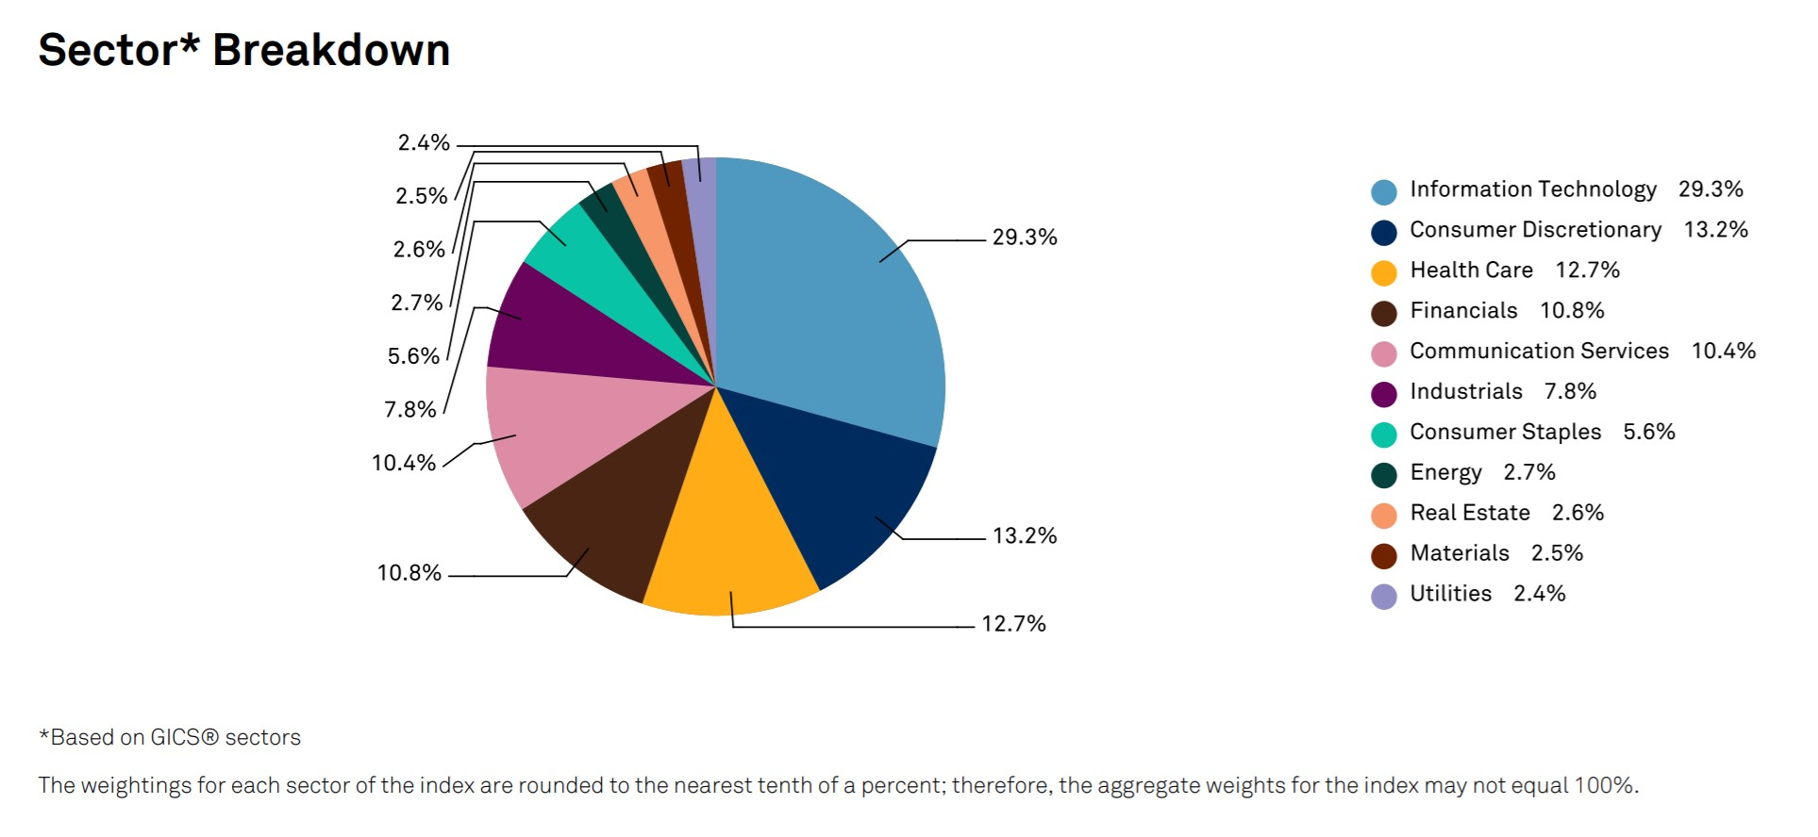
Stock Market and S&P index
The S&P (standard and poor) 500 is a stock market index composed of ~500 of the leading publicly-traded
companies.

Slide 3
Motivation
S&P 500 is a key indicator of the health and direction of the U.S. stock market.
S&P 500's influence extends beyond the United States.
Many investors and fund managers,e.g., hedge fund, use the S&P 500 as a benchmark to evaluate the performance of their investments.
Many financial products, such as index funds and exchange-traded funds (ETFs), are designed to track the performance of the S&P 500.

Slide 4
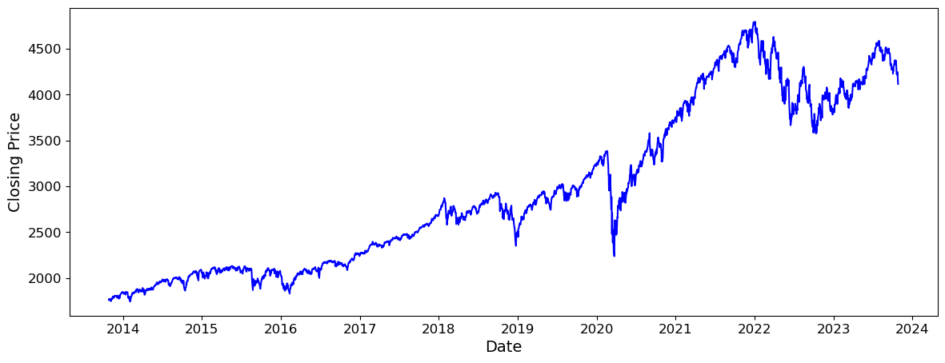
The Data: First Look and Preprocessing
The S&P 500 dataset for the last 10 years was sourced from www.nasdaq.com
The dataset was well-organized but minor cleanup and reorganization was performed
Other features and quantities, like rolling averages, differences, fractional changes were created and explored to understand the data better
The closing price has an upward trend, however, fluctuates heavily on a more microscale

Slide 5
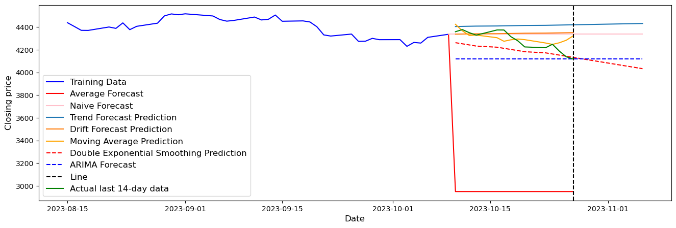
Exploratory Data Analysis
To forecast the closing price of S&P 500 index, we trained and tested a large variety of models. A subsample is shown on the right.
The models are rigorously validated using time-series cross-validation techniques to ensure robust performance.
We use the root mean square error (RMSE) to quantify the accuracy of these forecasts in the regression tasks

Slide 6
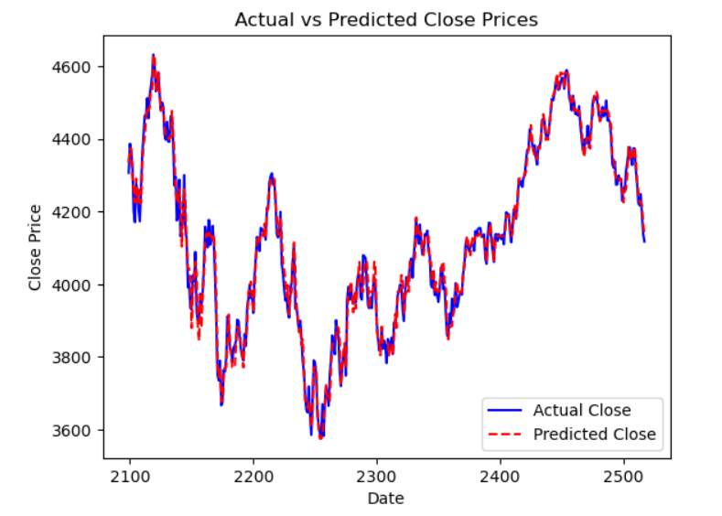
Gradient Boosting for Regression
We get best performance with the Gradient Boosting Regressor
This method produces a strong forecast from an ensemble of weak learners
The features used to train and predict the closing price were the previous 3 days’ value.
We tune for the parameters: number of weak learners and learning rate to find the most accurate forecast
We use cross validation by splitting the data into 25 splits
On the left, we see a forecast with 120 learners and learning rate = 0.07
On the testing set, this has a RMSE of 31.34 and a Max Absolute Error Percentage of 2.01% and Mean Absolute Error Percentage of 0.57%. This means on any given day, the prediction was no worse than 2% of the actual value and the average prediction is 0.57% away from the actual value.

Slide 7
Gradient Boosting for Regression
We get best performance with the Gradient Boosting Regressor
This method produces a strong forecast from an ensemble of weak learners
The features used to train and predict the closing price were the previous 3 days’ value.
We tune for the parameters: number of weak learners and learning rate to find the most accurate forecast
We use cross validation by splitting the data into 25 splits
On the left, we see a forecast with 130 learners and learning rate = 0.07
On the testing set, this has a RMSE of 31.37 and a Max Absolute Error Percentage of 2.01%. This means on any given day, the prediction was no worse than 2% of the actual value.

Slide 8
What’s the point?
S&P data gives insight into the overall market trend.
Investors can use this to make an informed decision to buy, sell, or hold stocks or indexes that mirror the S&P 500 index.
This index is often seen as an indicator of the broader economy’s health, so it may help:
companies align their goals with market expectations and adjust their strategies.
policymakers make informed decisions about fiscal policies.
day traders capitalize on short term predictions to make quick decisions.

Slide 9
Remarks and Possible Future Work:
The key challenge in financial forecasting stems from a multitude of factors affecting the price fluctuations. It would be beneficial to bootstrap these methods with more qualitative ideas, like sentiment analysis.
While we have experimented with some combination and ensemble methods, further exploration holds promise, by perhaps borrowing tools from network science and topological data analysis [1].
An ambitious future work could involve developing a streamlined pipeline that executes a large variety of methods, thereby picking out the best forecasting strategy tailored to the stock or index based on its behavior.
We also attempted to study the data via a classification problem: one that answers whether the price goes up or down. We were unable to get favorable results, so one direction we are interested in is exploring feature engineering to enhance accuracy.
[1] How topology is applied in financial market analysis, Medium (Link)

Slide 11
Exploratory Data Analysis
To predict the closing price we trained our data models:
The models are rigorously validated using time-series cross-validation techniques to ensure robust performance
The root mean square error (RMSE) is employed to quantify the accuracy of forecast in the regression tasks
Moving average
Double exponential smoothing
ARIMA
Average forecast
Naive forecast
Trend forecast
Random walk with a drift

Slide 12
Gradient boosting

Slide 13
To predict the closing price we trained our date with the following models:
Average forecast
Naive forecast
Trend forecast
Random walk with a drift
The models are rigorously validated using time-series cross-validation techniques to ensure robust performance
The root mean square error (RMSE) is employed to quantify the accuracy of forecast in the regression tasks
Moving average
Double exponential smoothing
ARIMA

Slide 14
Our data-closing price
Our dataset is the S&P index closing prices over the last 10 years and was obtained from www.nasdaq.com
The data is cleaned to handle missing values and outliers
The closing price has an upward trend.

Slide 15
Future directions
This project aims to provide accurate and reliable predictions of S&P 500 index prices, aiding
investors
financial analysts
in making informed decisions.
A future question we are interested in is developing a pipeline that automatically picks out the best method from a variety of methods for different stocks and indices.

Slide 16
Classification Approach
Techniques:...
Results: Compare Accuracy scores

Slide 17
Data Processing
convert date to a datestamp.
Drop the data on holidays
Reverse the data so that the date is increasing

